Slide 1

Individual Level Database (ILDB) Workgroup
Snehit Prabhu ClinGen Steering Committee Meeting
October 5th 2015

Slide 2
ClinGen ILDB Concept and utility of case-level queries
Variant-level Queries
Gene-level Queries
Phenotype information
Individuals

Slide 3
ClinGen ILDB Concept and utility of case-level queries
Variant-level queries
Gene-level queries
Phenotype queries
Case-level
Queries
Individual
queries
Individuals
Summary queries
Pedigree queries
e.g. ClinVar, DbSNP
e.g. ClingenKB
e.g. EMR? Epi databases?

Slide 4
ClinGen ILDB Example ILDB queries for pathogenicity assessment
For an individual with an autosomal recessive disease: Is this variant cis/trans with another pathogenic variant? (BP2, PM3)
For an individual with an autosomal dominant disease: Is there a different pathogenic variant in the same/other gene in the patient that could explain the disease? (BP5)
Has this variant ever been seen de-novo in a case? (PM6, PS2)
What is the distribution of phenotypes of all cases having the variant of interest? (PP4)
What were the phenotypes/genotypes of all the proband’s family members who were tested? (BS4, PP1, PM6, PS2)
Systematic identification and specification of queries is ongoing …

Slide 5
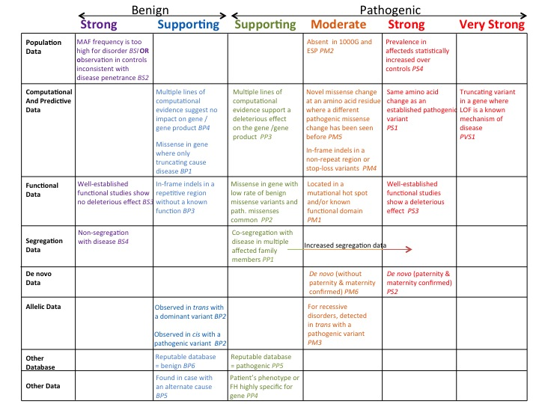
ClinGen ILDB Example ILDB queries for pathogenicity assessment

Slide 6
ClinGen ILDB Powered by GeneInsight

Slide 7
ClinGen ILDB In the context of variant curation workflow

Slide 8
ClinGen ILDB
Implementation Team
Sandy Aronson
Samantha Baxter
Selina Dwight
Shana White
Tam Sneddon
Carlos Bustamante
Heidi Rehm
Sharon Plon
Monthly updates on the informatics calls (3rd Monday every month) https://github.com/snehitp/ClinGen-ILDB

